Slide 1
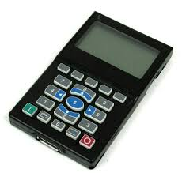

20-HIM-A6 HIM CopyCat File Upload / Download Procedures

Slide 2
CopyCat Procedure - Definitions
The Allen Bradley 20-HIM-A6 is a Human Interface Module (HIM) for the PowerFlex 750 and PowerFlex 755T AC drives. It is a keypad and display interface that provides local control and monitoring of the drives.
The CopyCat procedure is a feature of the 20-HIM-A6 that allows users to quickly and easily copy parameter settings from one drive to another. This is useful for applications where multiple drives need to be set up with the same parameters.
Upload is defined as transferring files from the VFD to the HIM Module.
Download is defined as transferring files from the HIM Module to the VFD

Slide 3
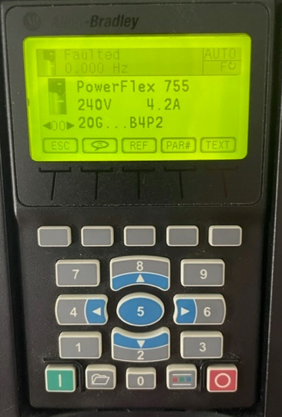
CopyCat Uploading Procedure – Step 1
Press the “Folder Key” at the bottom of the HIM

Slide 4
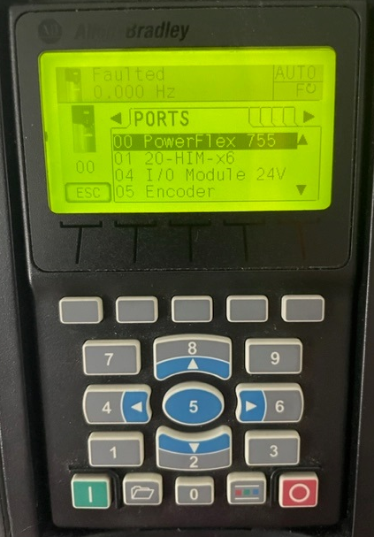
CopyCat Uploading Procedure – Step 2
Press the “Blue Left & Right Arrows” to select the “Memory Folder”

Slide 5
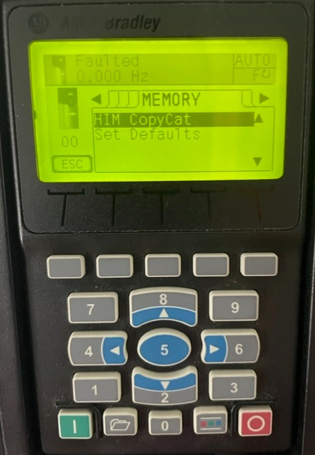
CopyCat Uploading Procedure – Step 3
Use the blue “Up & Down Arrows” to highlight “HIM Copycat” and then press the blue “5” (Enter) key

Slide 6
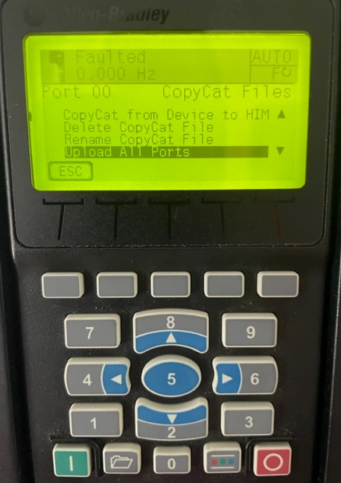
CopyCat Uploading Procedure – Step 4
Use the blue “Up & Down Arrows” to highlight “Upload All Ports” and then press the blue “5” (Enter) key
Warning: If you select “CopyCat from Device to HIM”, you will only get Port 0 which means that all of the parameters for the other ports will not be saved.

Slide 7
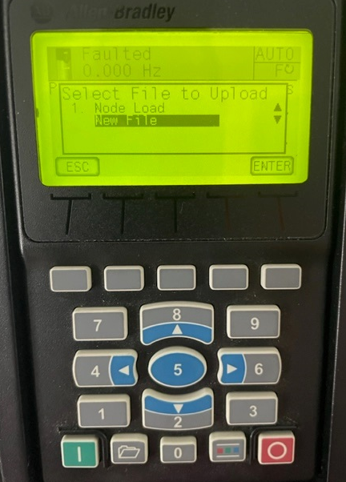
CopyCat Uploading Procedure – Step 5
Use the blue “Up & Down Arrows” to highlight “New File” and then press the blue “5” (Enter) key
NOTE: If you have a file already saved in the HIM, you can select it and it will be overwritten with the current parameters.

Slide 8
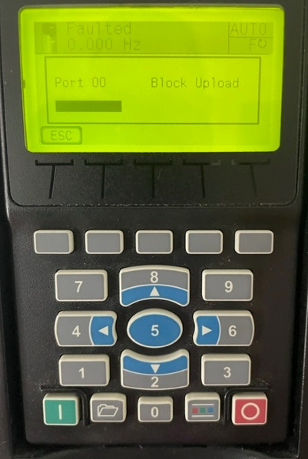
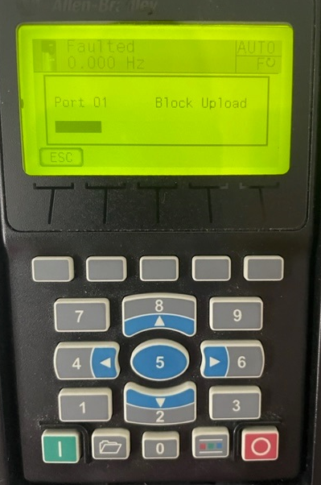
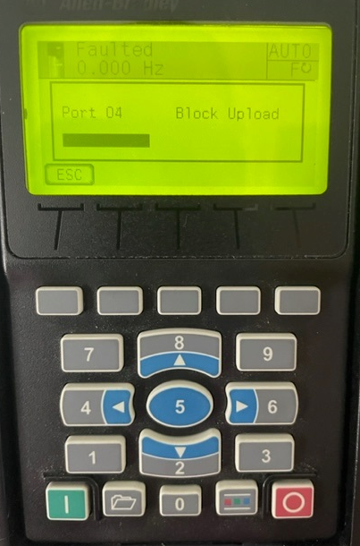
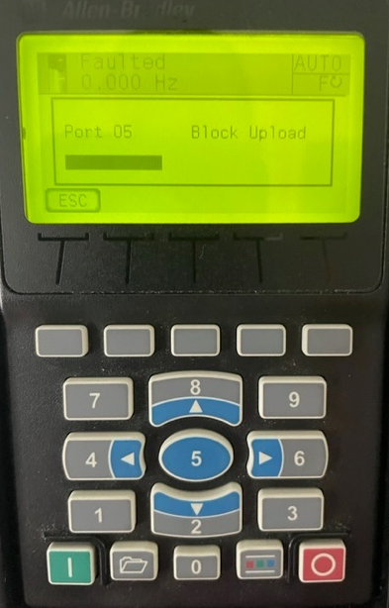
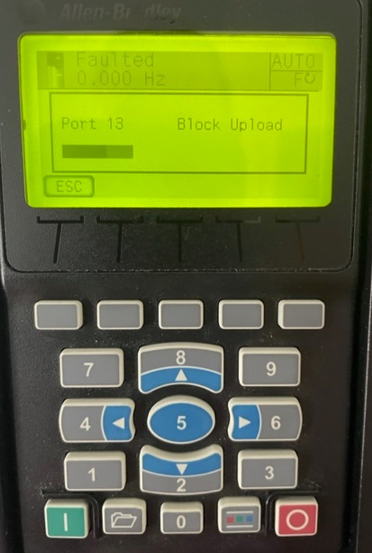
CopyCat Uploading Procedure – Step 6
Depending on how many ports are being used in the drive (IO Cards, Encoders Cards, Safety Cards, etc.., the HIM will store the parameters for each port.

Slide 9
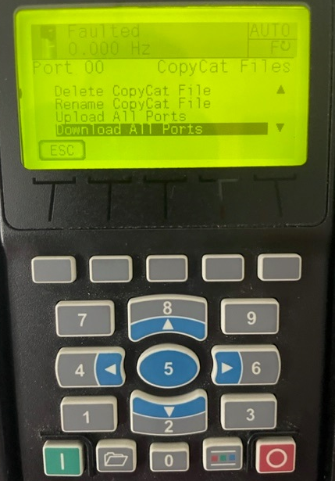
CopyCat Downloading Procedure – Step 1
Use the blue “Up & Down Arrows” to highlight “Download All Ports” and then press the blue “5” (Enter) key

Slide 10
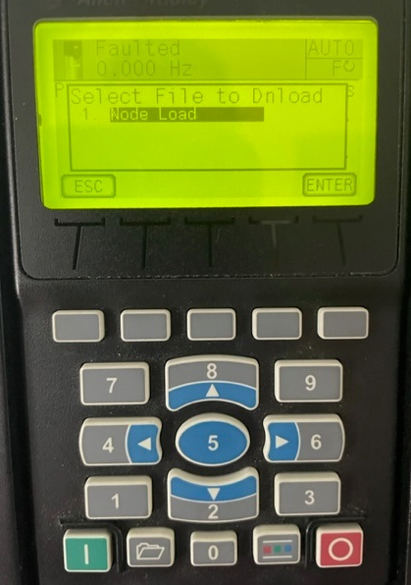
CopyCat Download Procedure – Step 2
Use the blue “Up & Down Arrows” to highlight the “File Name” to be downloaded and then press the blue “5” (Enter) key

Slide 11
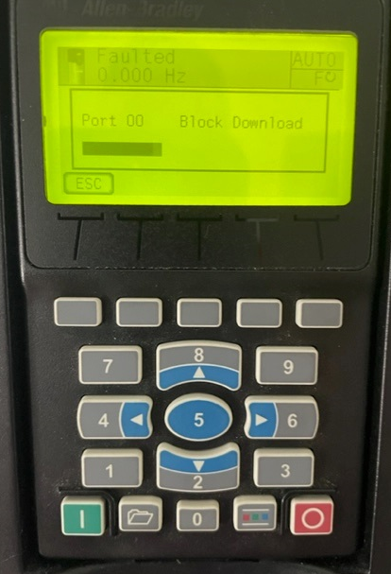
CopyCat Download Procedure – Step 3
All Ports will be downloaded to the PowerFlex Drive

Slide 12
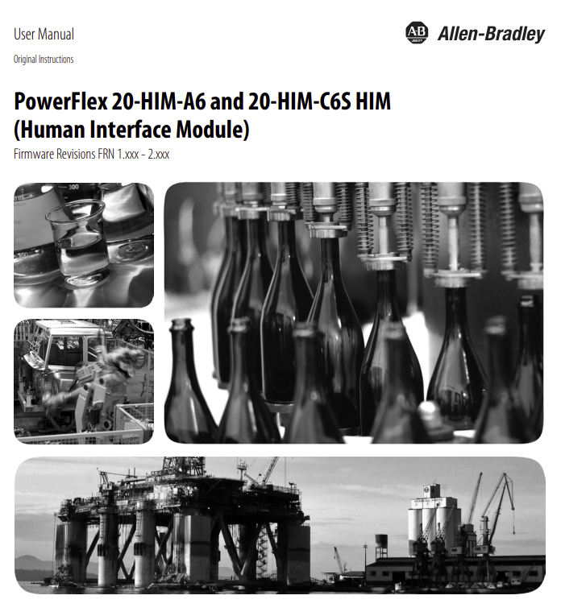
20-HIM-A6 References
https://literature.rockwellautomation.com/idc/groups/literature/documents/um/20him-um001_-en-p.pdf

